Slide 1

Benchmarking Vector Databases on Code Embeddings
CS 854 – Performance Engineering
Fall 2023, Ali Mashtizadeh
Vikram Subramanian, Raymond Chang, Yahya Jabary

Slide 2
Benchmarking Vector Databases on Code Embeddings
N-dimensional, float
Vector representations of documents
Notes:
First of all to clear up some terminology, what is a code embedding?
So a code embedding is a representation of a document and its basically an n dimensional array or vector
Each entry of this vector is a float

Slide 3
What are vector databases?
Specifically designed to store and retrieve vectors
Given query vector q [0, 0.3, 0.1]
Retrieves approximately similar vectors to q
Similarity depends on DB load
Ex: MilvusDB, ChromaDB
Notes:
Now what are vector databases?
They’re databases that are specifically designed to store and retrieve the vectors we talked about in the previous slide
So for example, a query would be some vector q and the database would return a list of approximately similar vectors to q
I say approximately because the similarity depends on the database load so if you have high load you could end up with result vectors that are not the most similar vectors
There are several vector databases that exist today, for example MilvusDB and ChromaDB

Slide 4
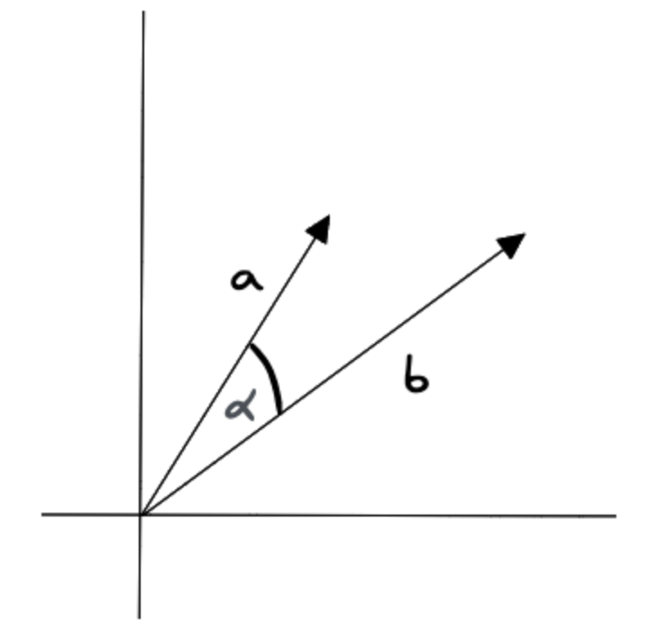
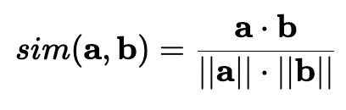
How do they work? - Similarity
Cosine Similarity
Notes:
Now I’ll briefly talk about some important concepts in vector databases
The first is, how do we determine whether two vectors are similar
There are multiple metrics that may be used but the one that we used is cosine similarity
So in this example, we have two vectors a and b.
To determine the cosine similarity we take the dot product of the two vectors and divide that by their magnitude

Slide 5
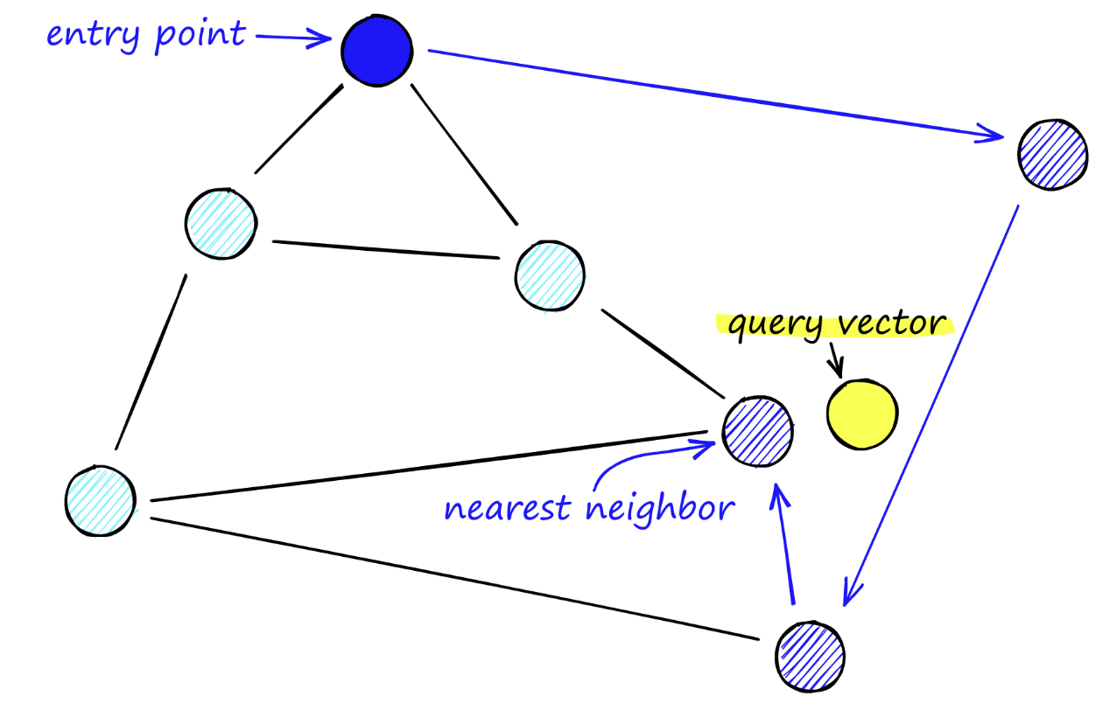
How do they work? - Indexing
Navigable Small Worlds
Vector
Notes:
Vector databases also have indexes
There are many different ways to create indexes but the one I’ll talk about today is navigable small worlds
So each point in this graph above is a vector that would be stored in our database
Our query vector is highlighted in yellow and its nearest neighbor is marked
Edges are built between the vectors in the graph and we traverse the graph in a greedy fashion
Here’s an example of the algorithm,
We start at the entry point and we compare the similarity of the query vector with the neighbors of this node
We go to the node with the highest similarity
Once we reach a node with no neighbors that are closer to the query vector, we stop and return the current vector
This algorithm was succeeded by HNSW which expands on this but now we have a basic idea of what an index could look like

Slide 6
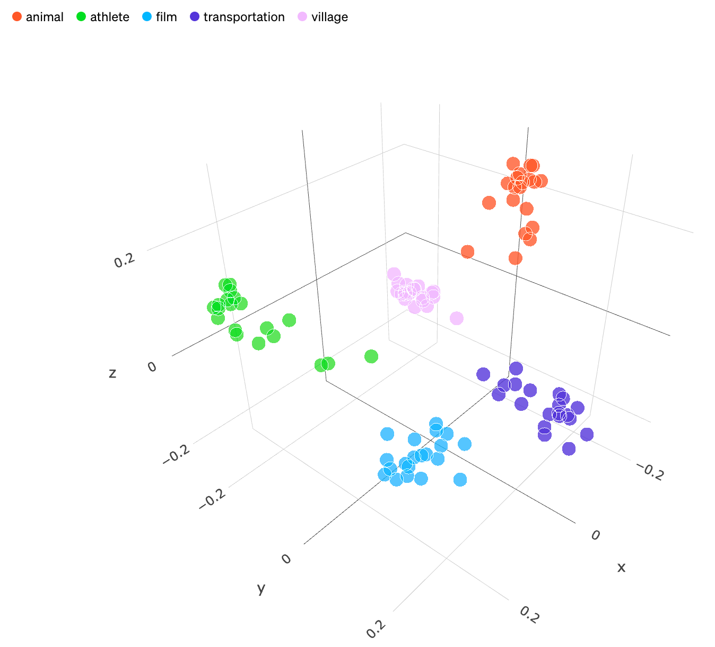
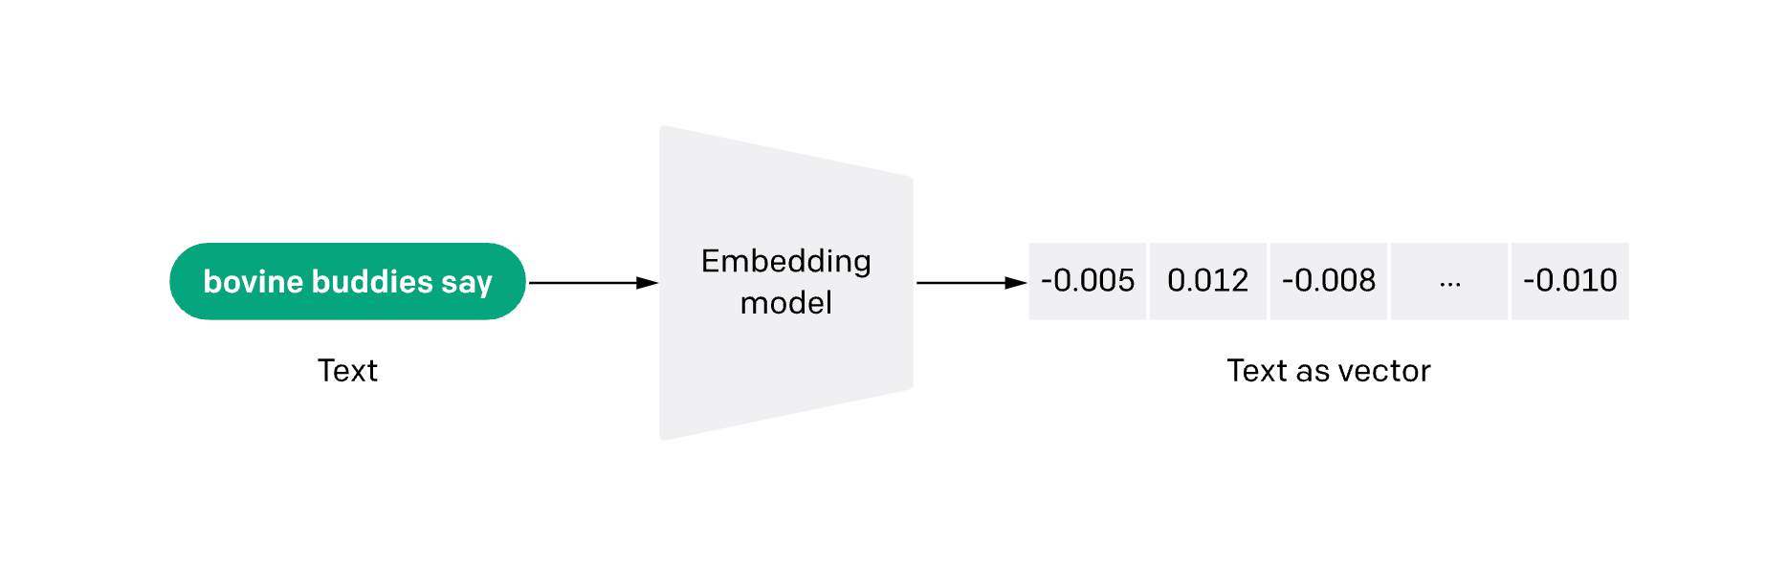

Slide 7
Why should I care?
Novelty:
No standard test dataset for code
New Vector DBs every month
Practicality: used in many AI/ML apps
Searching and clustering files of code by semantics

Slide 8
What did we do?
Contributions:
A very large high-dimension (1024 dimension) dataset
First code benchmarking dataset
Some basic benchmarking

Slide 9
Why aren't there are many large high-dimensional datasets?
Computationally expensive
5*10^5 functions in our dataset and we use an embedding of 1024
We have 3*10^9 floats- We need to do 3*10^18 operations
Will take 1000 H100s, 3 days
Solution: Precompute nearest neighbors by generating mutations of code blocks

Slide 10
Step 1)
Getting initial dataset

Slide 11
Github API
Goal: 500.000+ files of code
Github API rate limits:
anonymous: 60 requests/h ⟶ +8,333h
authenticated: 5000 requests/h ⟶ +100h
enterprise: 15000 requests/h ⟶ +33h (and lots of money)

Slide 12
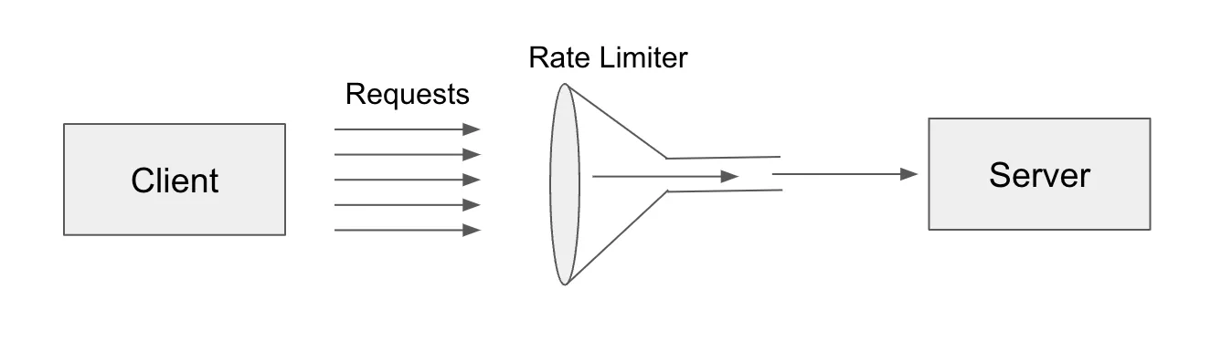
How does rate limiting work?
By identifying you through your:
IP address, geolocation (default)
API auth key
User session cookies (mostly Akamai)
HTTP requests (mostly Cloudflare)
TLS fingerprints (very rare)

Slide 13
Rotating IPs via XFF vulnerability
Rotating proxies for each request through:
AWS API Gateway’s large IP pool
BurpSuite PortSwigger IProtate
Result: Unsuccessful
Github detects popular proxy pool headers like “X-Amzn-Trace-Id”
We don’t want to pay for custom IP pools
HTTP Request:
GET /api/v1/otp/check HTTP/1.1
Host: vulnerable-website.com
Content-Type: application/x-www-form-urlencoded
Content-Length: 9
X-Forwarded-For: <client>, <proxy1>, <proxy2>

Slide 14
Fake resource paths
No semantics: %00, %09, %0a, %0c, %20, …
Bare endpoint: /api/v4/endpoint
/api/v4/endpoint
/api/v4/Endpoint
/api/v4/EndPoint
/api/v4/endpoint%00
/api/v4/%0aendpoint
/api/v4/endpoint%09
/api/v4/%20endpoint
Fake query params:
/api/v4/%20endpoint?phone=+17342239011&code[]=123456&code[]=654321&...&code[]=331337
Result: Unsuccessful

Slide 15
Token rotation / Overwriting ETags
$ curl -i https://api.github.com/users/defunkt
> HTTP/2 200
> ...
> etag: W/"61e9...f26f0"
$ curl -i -H 'If-None-Match: "61e9...f26f0"' \
https://api.github.com/users/sueszli
> HTTP/2 304
Result: Unsuccessful

Slide 16
Bandwidth throttling
from ratelimit import limits, RateLimitException
from backoff import on_exception, expo
import requests
@on_exception(expo, RateLimitException, max_tries=8)
@limits(calls=15, period=900) # <-- limit requests
def call_api(url):
response = requests.get(url)
if response.status_code != 200:
raise Exception('API response: {}'.format(response.status_code))
return response
Result: Unsuccessful – now we’re even slower

Slide 17
Scraping the Github “search” page
Lets you query by language and repository size
Only displays 5 pages when you get rate limited
Scraped around 500 entries manually
Result: Unsuccessful

Slide 18

Github, why?

Slide 19
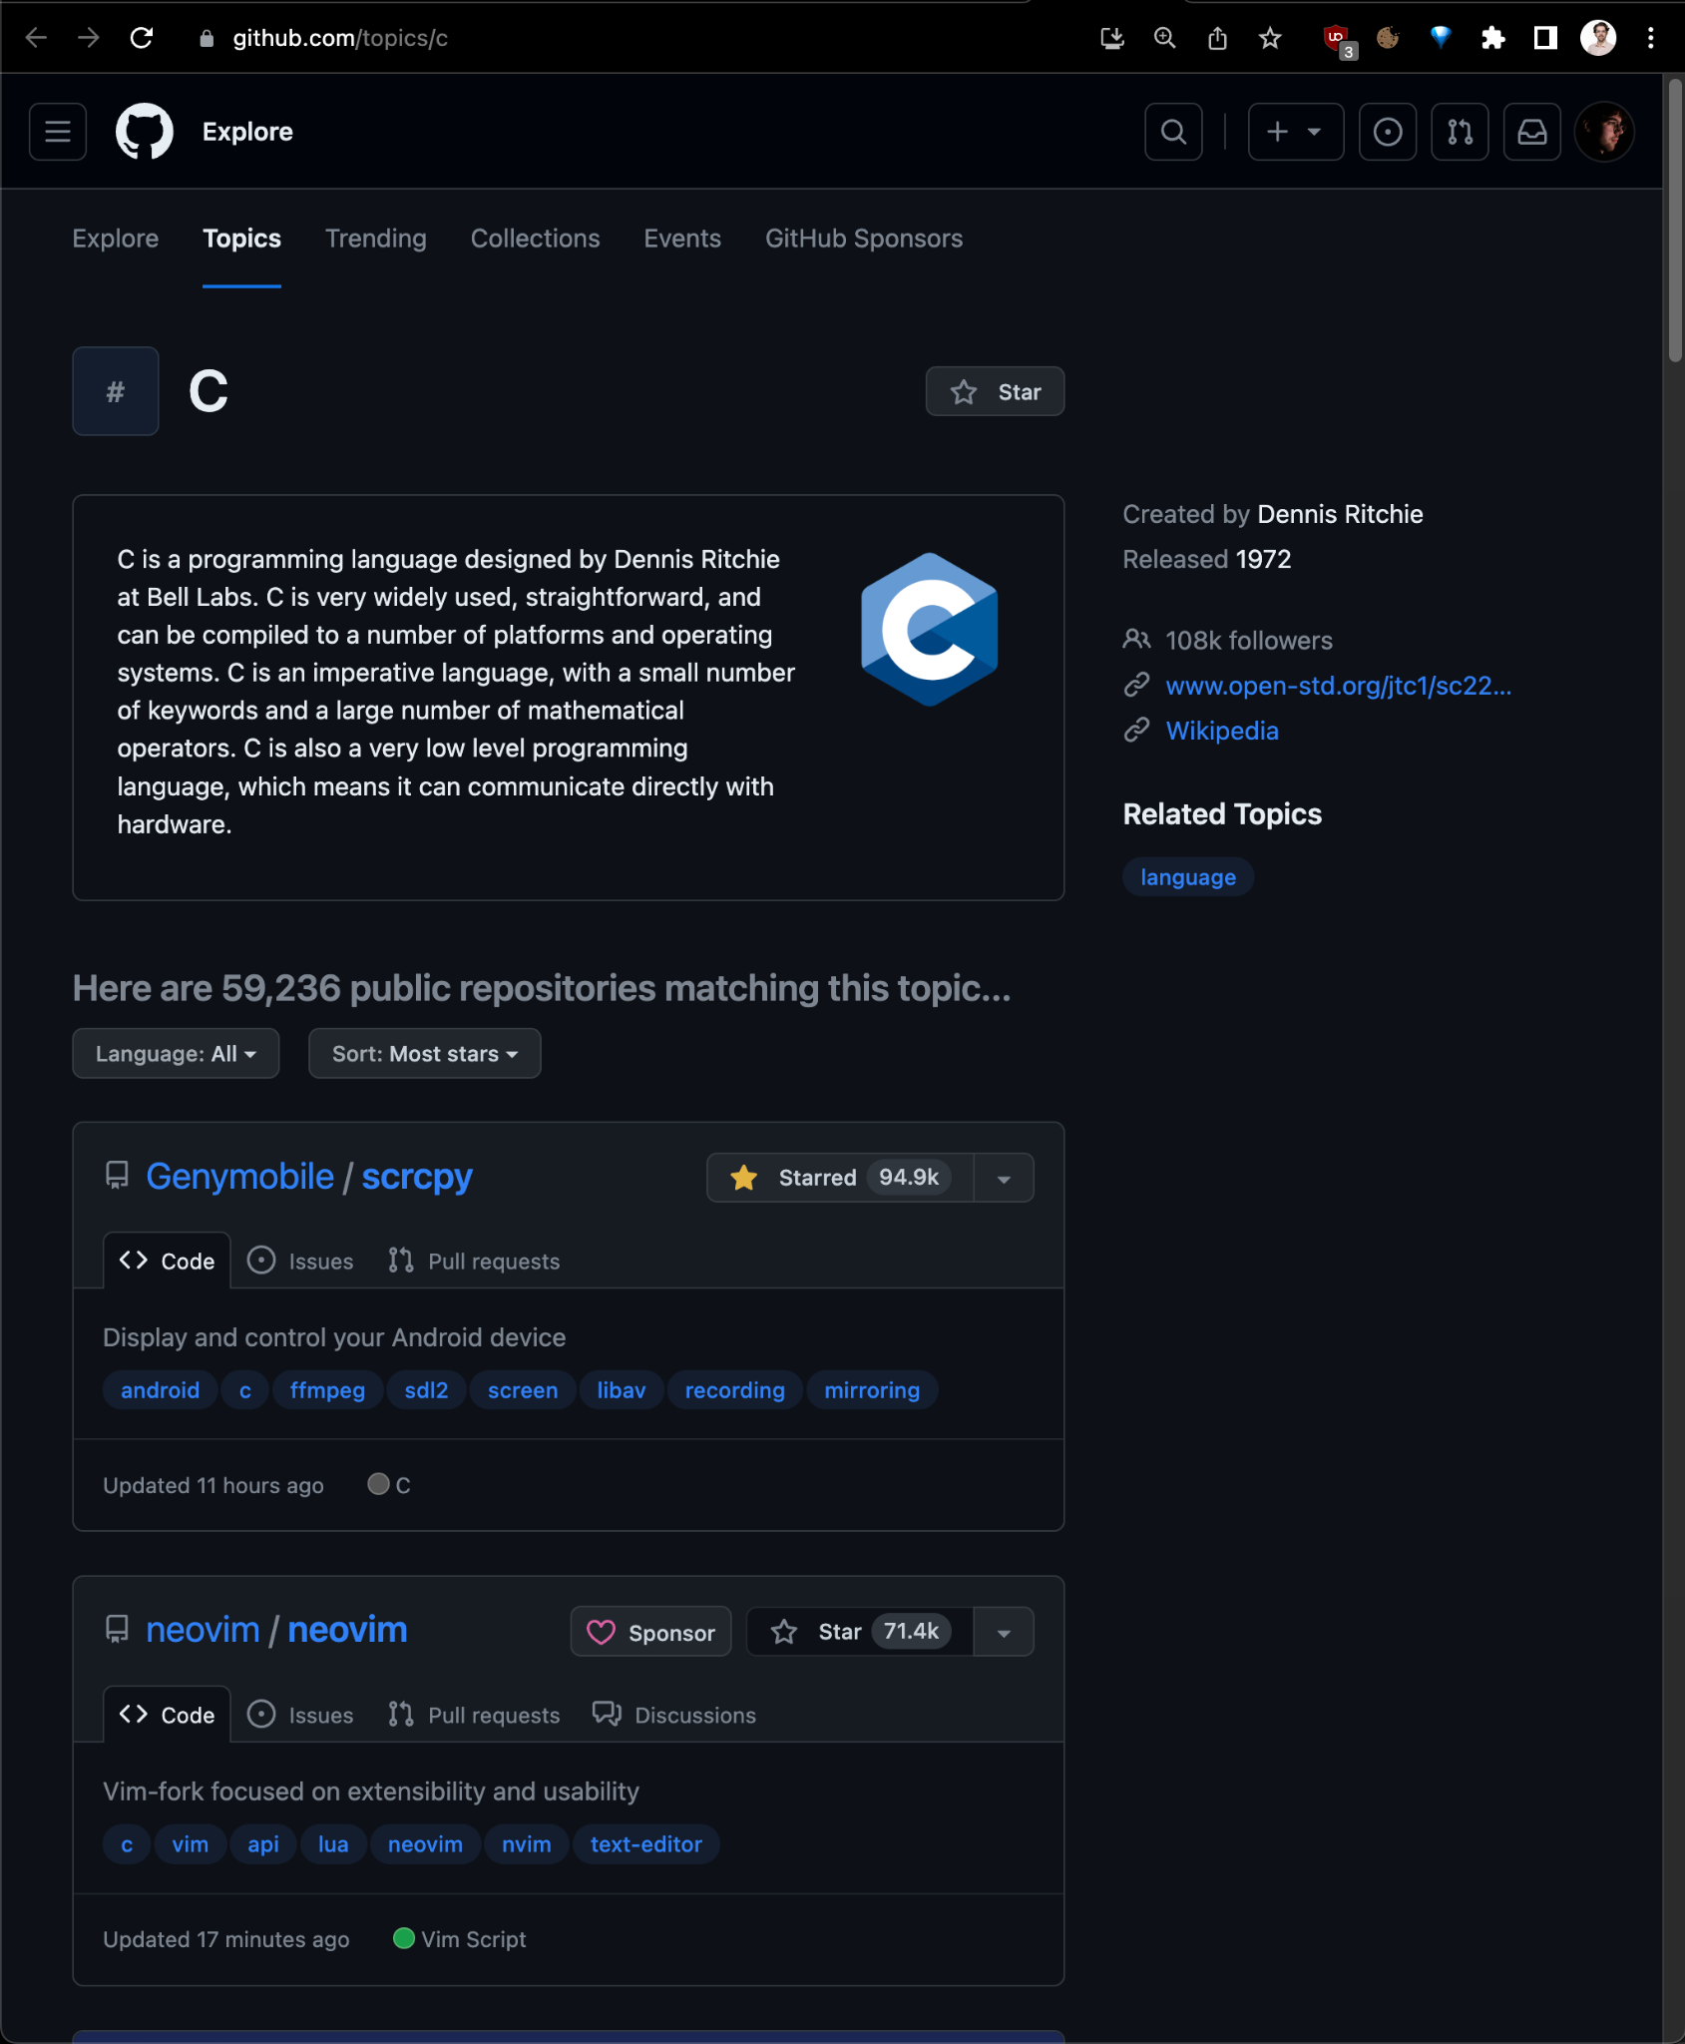
Scraping the Github “topics” page
Novel discovery: Single page scraping
2000 repositories per page or ~15 repos per second
Result: Very Successful

Slide 20
Final steps
Scrape links to repositories through “Github topics” Total repositories: 3,494
Clone
Filter out non-code Total files: 649,257
Chunk into 1,000 file commits (>600 commits in ~2 days) Otherwise you have to pay for Github LFS

Slide 21
Step 2)
Mutating data to generate clusters

Slide 22
Mutation
Must generate semantically similar code blocks
Mutation:
Insert block of dead code
For each function generate five mutated versions
Mutations increase in size
Notes:
The mutations we generate must be semantically similar to the original functions to ensure their vectors are similar
So what we do is mutate each function by inserting some dead code thus preserving the semantics
For each function we generate five mutated versions such that each successive mutant is more complex than the previous
Mutations have to be similar but not too similar to ensure recall drops

Slide 23
Mutation Example
Original
Mutations
1.
def foo():
if False:
i = 0
…
def foo():
…
JSON
2.
def foo():
if False:
i = 0
while(false):
…
…
…
Notes:
We were originally unsure about how complicated these mutations would have to be so we built a fairly general solution
We first start by parsing each function and generating an AST
We then traverse the AST and upon finding a function, insert some dead code right at the beginning
We then dump these mutations and their originals into json files to be parsed later

Slide 24
Mutation analysis
Want Recall vs db load
Must ensure mutations actually decrease similarity
Compare
Similarity of the two largest
0.68
Smallest function: Similarity with mutations
0.82 to 0.92
Largest function: Similarity with mutations
0.85 to 0.91
Notes:
One of the measurements we generated was how recall was affected by load on the database
We wanted to make sure that recall would actually decrease though so we had to make sure the mutations actually affected the similarity
We did this by converting some mutations into embeddings and measuring them
We first had to determine a baseline which was the largest difference in similarity we would encounter
We did this by comparing the similarity of the two largest functions which are fairly likely to be the most different semantically and got a cosine similarity of 0.68
We then checked the similarity of the smallest function with its mutations as well as the largest function and found that their similarity does actually differ

Slide 25
Step 3)
Benchmarks

Slide 26
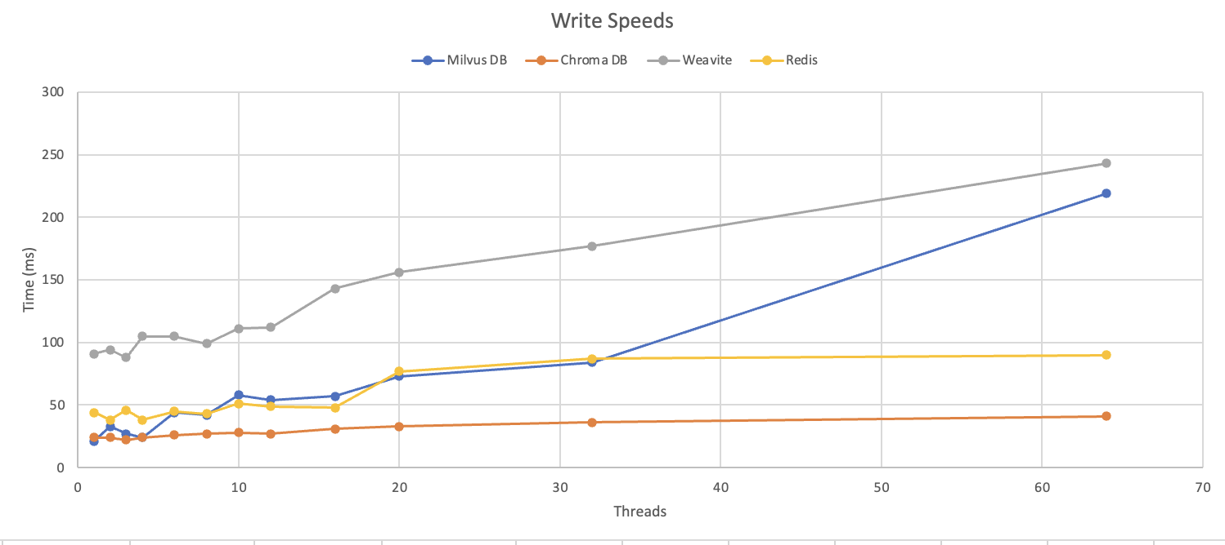

Slide 27
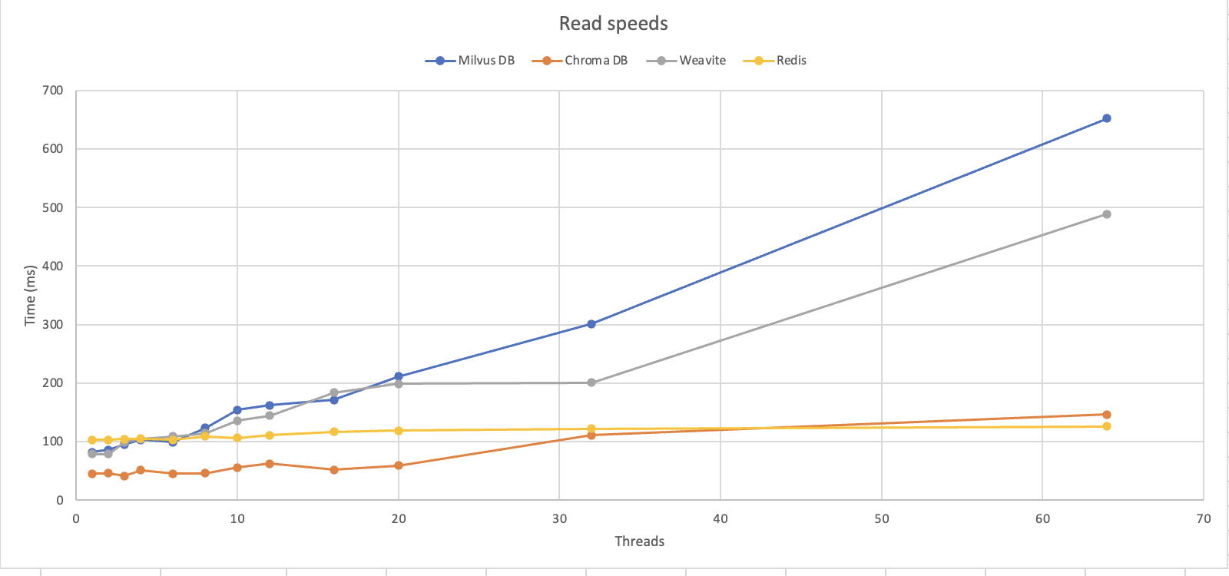

Slide 28
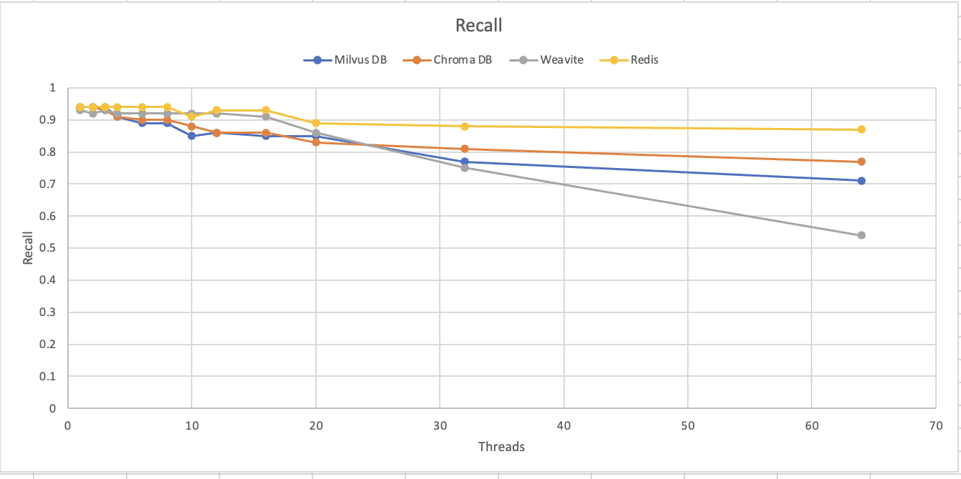

Slide 29
Threats to validity of this approach
Even on a perfect system, recall < 1.
Ie, our data is imperfect
Ie, given a code block x and mutation x’, there exists a code block y whose cosine similarity to x is greater than the cosine similarity between x and x’
Databases under minimal load produced a recall of 0.99 with a perfect dataset. The same DB produced a recall of 0.94.

Slide 30
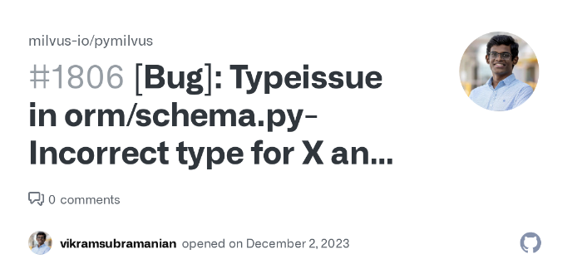
Conclusion
Created a large high-dimensional dataset for VectorDB benchmarking
Used a novel method to create a code dataset
Benchmarked some popular vector databases

Slide 31
Thanks for listening!

Slide 32
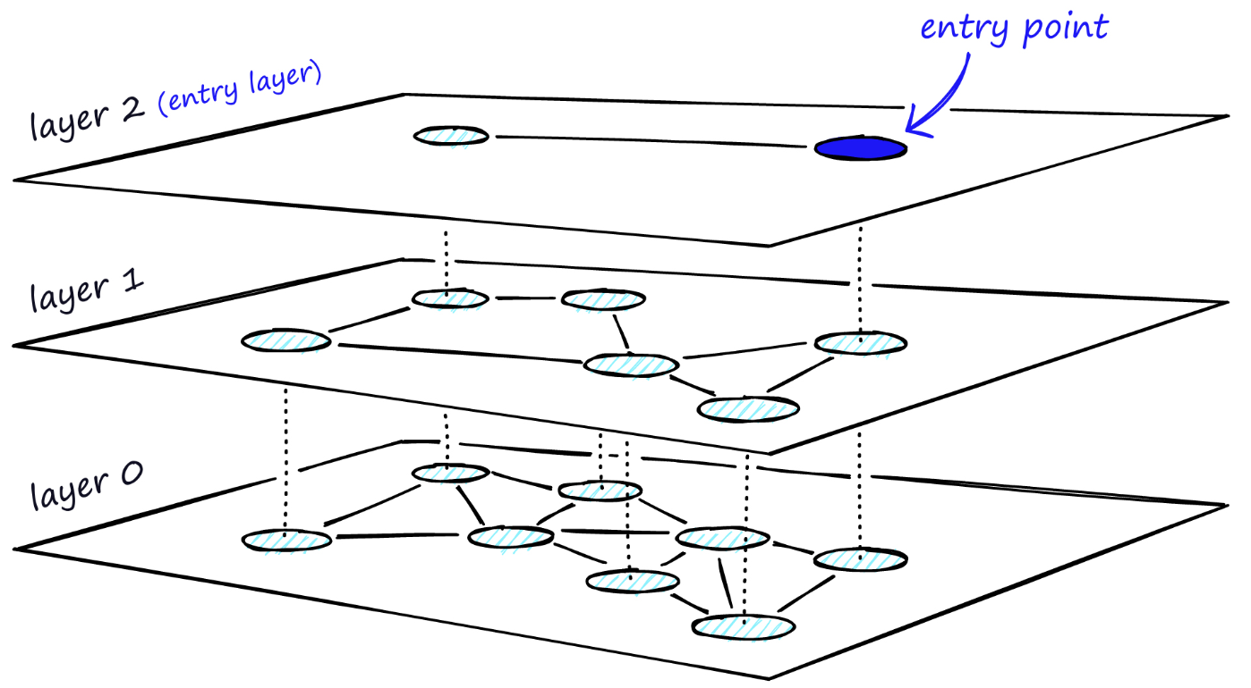
How do they work? - Indexing
Hierarchical Navigable Small Worlds
Same vector
Notes:
Hierarchical Navigable Small worlds takes navigable small worlds and cuts the graph into several layers

Slide 33
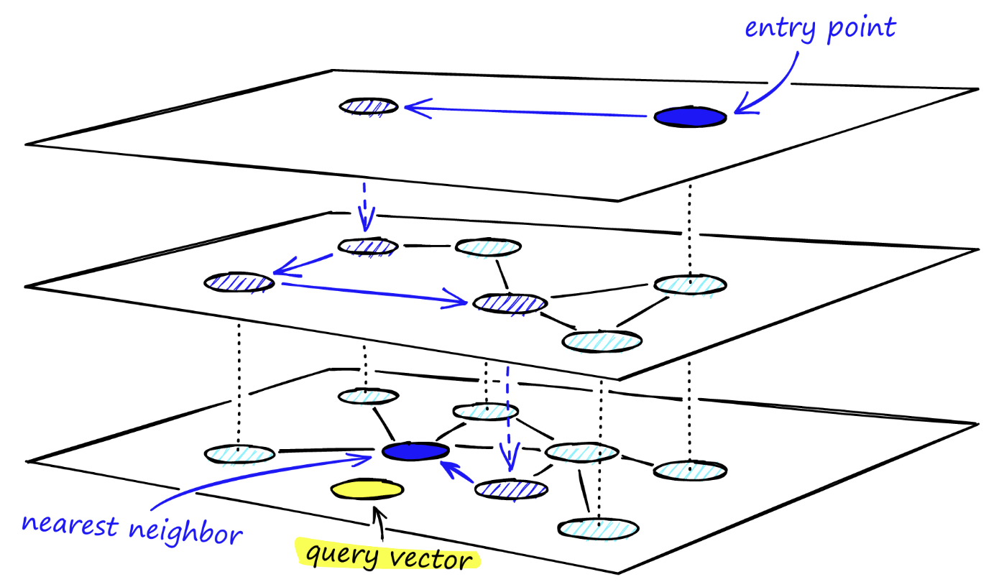
How do they work? - Indexing
Hierarchical Navigable Small Worlds

